Slide 1
Lecture 14-15: Markov chain

Slide 2
A Markov chain, named after Andrey Markov, is a mathematical system that undergoes transitions from one state to another, between a finite or countable number of possible states.
It is a random process usually characterized as memoryless: the next state depends only on the current state and not on the sequence of events that preceded it. This specific kind of "memorylessness" is called the Markov property

Slide 3
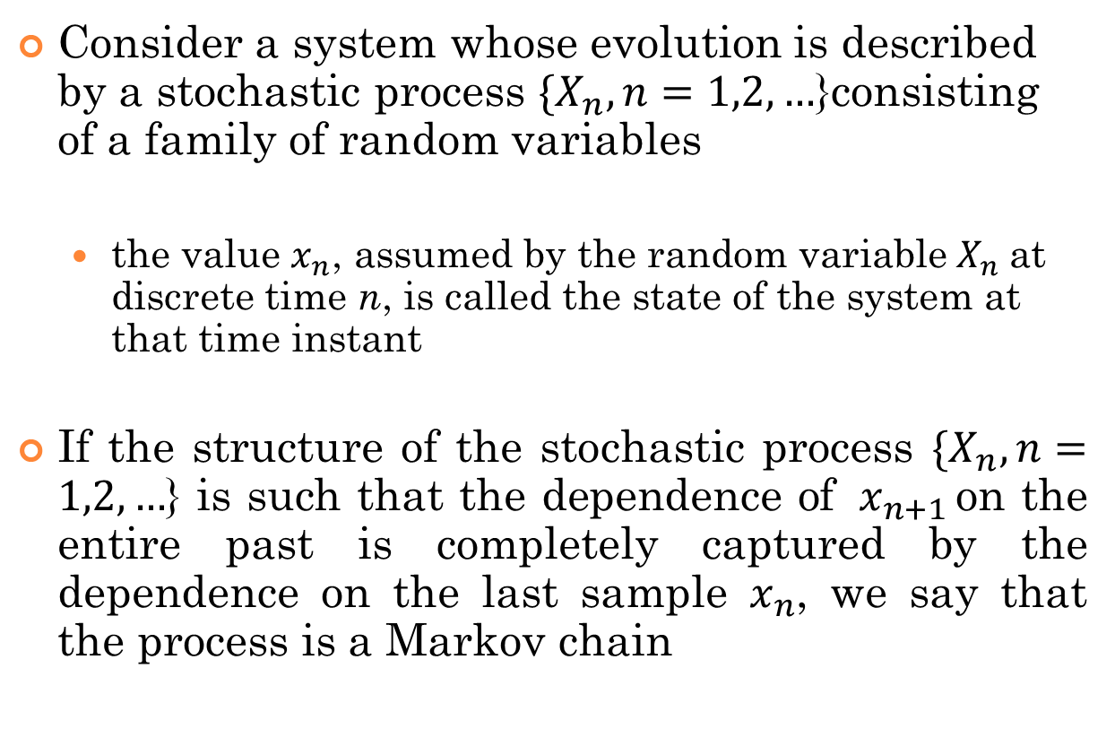
Cont.…
Consider a system whose evolution is described by a stochastic process ${\{X}_{n}, n=1,2,…$}consisting of a family of random variables
the value $x_{n}$, assumed by the random variable${ X}_{n}$at discrete time n, is called the state of the system at that time instant
If the structure of the stochastic process ${\{X}_{n}, n=1,2,…$} is such that the dependence of ${ x}_{n+1 }$on the entire past is completely captured by the dependence on the last sample $x_{n}$, we say that the process is a Markov chain

Slide 4
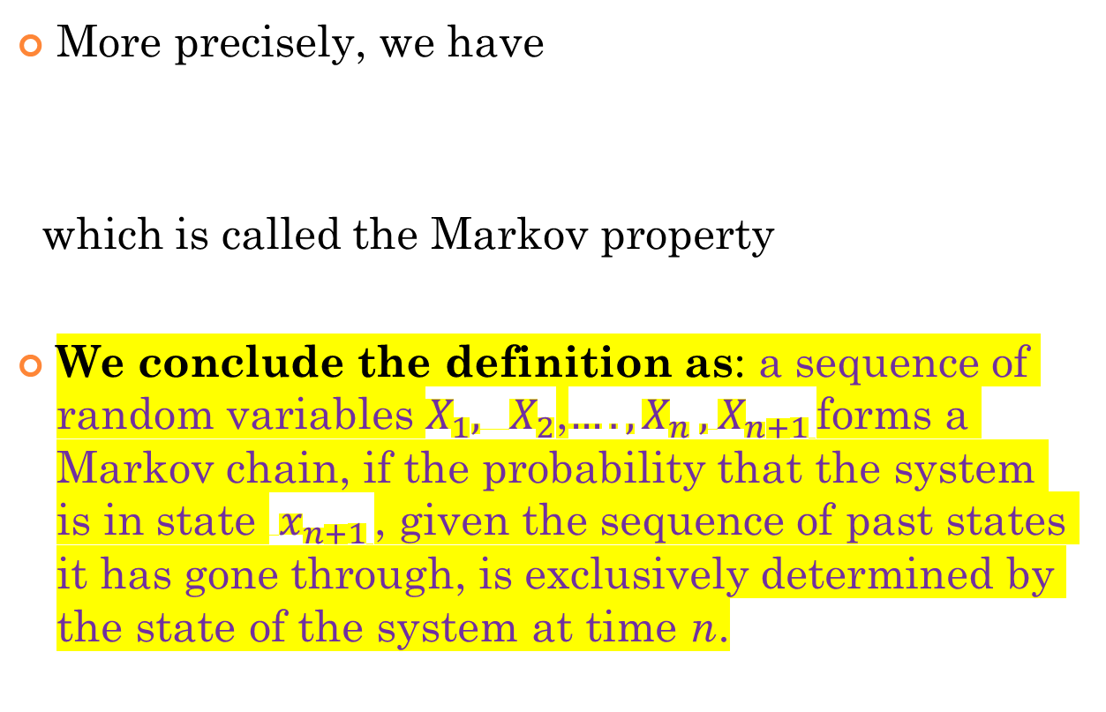
Cont.
More precisely, we have
which is called the Markov property
We conclude the definition as: a sequence of random variables $X_{1}, { X}_{2}$,${…. ,X}_{n},{ X}_{n+1 }$forms a Markov chain, if the probability that the system is in state ${ x}_{n+1 }$, given the sequence of past states it has gone through, is exclusively determined by the state of the system at time n.

Slide 5


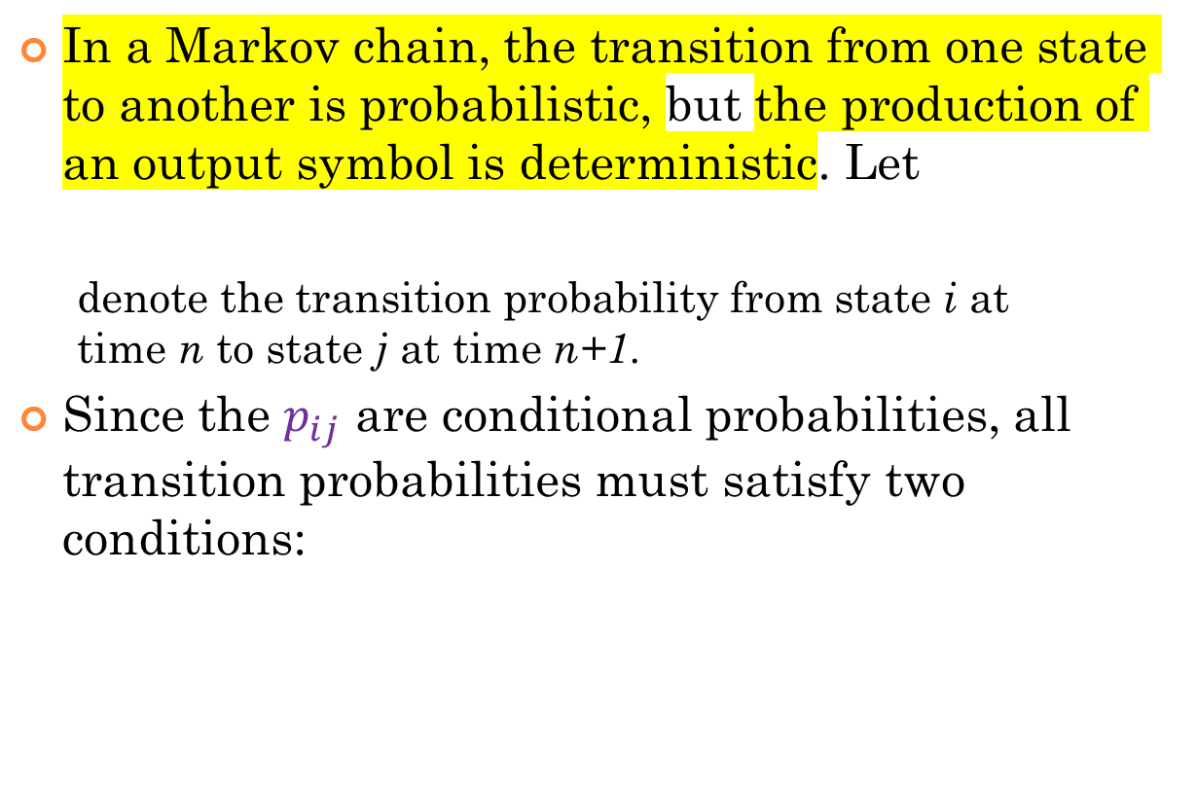
transition probabilities
In a Markov chain, the transition from one state to another is probabilistic, but the production of an output symbol is deterministic. Let
denote the transition probability from state i at time n to state j at time n+1.
Since the $p_{ij}$ are conditional probabilities, all transition probabilities must satisfy two conditions:

Slide 6
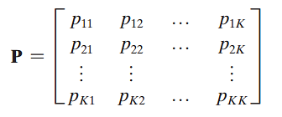
Cont.…
In the case of a system with a finite number of possible states K, for example, the transition probabilities constitute the K-by-K matrix
A matrix of this type is called a stochastic matrix. Any stochastic matrix can serve as a matrix of transition probabilities

Slide 7
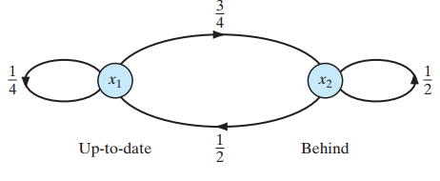
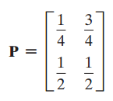
Example: transition probability
Consider a Markov chain whose state-transition diagram is depicted in the figure
The stochastic matrix of the chain is

Slide 8
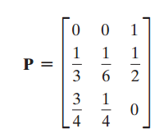
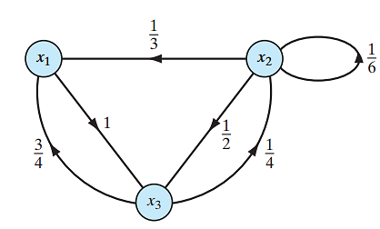
Example: transition probability
Consider a Markov chain with a stochastic matrix, some of whose elements are zero, as shown by
The state transition diagram of the chain?

Slide 9
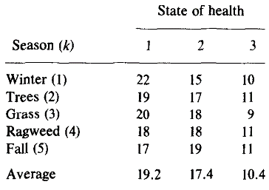
Application of Markov chain
Consider that the condition of an asthmatic patient is modeled by a three state Markov chain:
a patient in State 1 under self-care,
in State 2 under intermediate care, and
in State 3 under intensive care.
The patients’ states is described by the following matrix
Seasons are determined on basis of daily airborne allergenic pollen counts.

Slide 10
Application of Markov chain (cont.…)
How many self-care (%), intermediate care (%), and intensive care (%)?

Slide 11
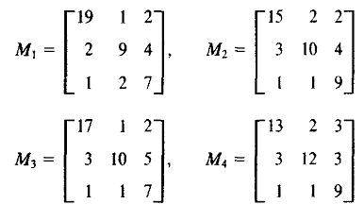
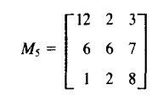
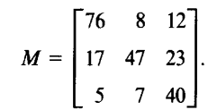
Application of Markov chain (cont.…)
The transition count matrices were estimated for various seasons and are given
Thus, we can write
Calculate the likelihood of M.

Slide 12
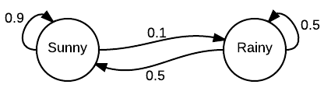

Example: A simple weather model
The probabilities of weather conditions (modeled as either rainy or sunny), given the weather on the preceding day, can be represented by diagram
Transition matrix is

Slide 13


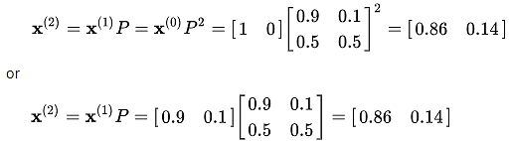
Cont.
Predicting the weather
Suppose the weather on day 0 is known to be sunny. This is represented by a vector in which the "sunny" entry is 100%, and the "rainy" entry is 0%:
The weather on day 1 can be predicted by:
The weather on day 2 can be predicted in the same way:

Slide 14

Cont.…
What about weather for long run/all days?
In this case ,the prediction is independent on the initial condition, i.e.
predictions for the weather on more distant days are increasingly inaccurate and tend towards a steady state vector, defined as
The steady state vector x satisfies the equation xP = x
That is, it is an eigenvector for the eigenvalue λ = 1
If P is a stochastic matrix then a steady state vector for P is a probability vector q such that
qP=q.

Slide 15
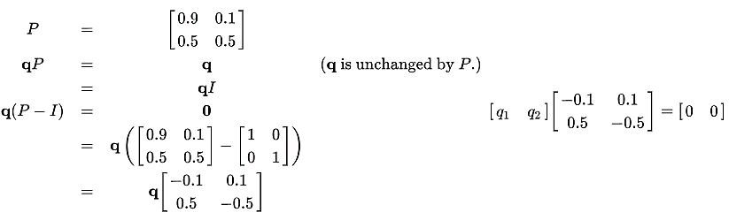

Cont.…
Now,
So $−0.1q_{1}+0.5q_{2}=0$ and $0.1q_{1}−0.5q_{2}=0$; since they are a probability vector we know that
Solving this pair of simultaneous:
In conclusion, in the long term, about 83.3% of days are sunny.

Slide 16
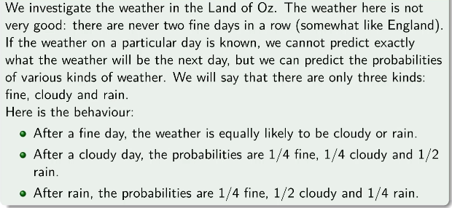
Exercise
Find the weather state for long run/for more days.
Source:
https://www.youtube.com/watch?v=pUCIW1V0HIE

Slide 17
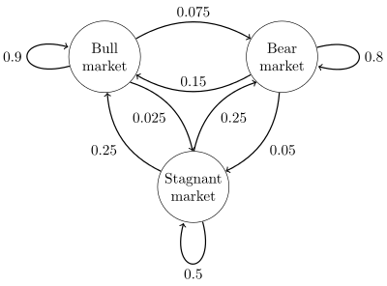
Example: stock market prediction
Consider a transition diagram that represents whether a hypothetical stock market is exhibiting a bull market, bear market, or stagnant market trend during a given week.

Slide 18

Cont.…
Transition matrix is
The distribution over states can be written as a stochastic row vector x with the relation x^{(n + 1)} = x^{(n)}P.
if at time n the system is in state x^{(n)}, then three time periods later, at time n + 3 the distribution is

Slide 19
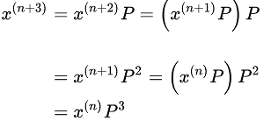
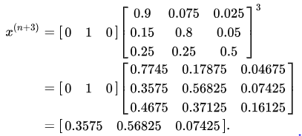
Cont.…
In particular, if at time n the system is in state 2 (bear), then at time n + 3 the distribution is

Slide 20

Markov Process
A continuous time stochastic process {X_{t}, t ≥ 0} with state space E is called a Markov process provided that
for all states i, j ∈ E and all s, t ≥ 0.

Slide 21
references
Neural Networks and Learning Machines, Simon Haykin, 3rd edition
Jain, Sudha. "Markov chain model and its application." Computers and biomedical research 19.4 (1986): 374-378.
https://en.wikipedia.org/wiki/Examples_of_Markov_chains
https://en.wikipedia.org/wiki/Markov_chain

